Slide 1
Lecture 6
Stochastic processes: Doubly-stochastic chains
Detailed-balanced condition
Statistical computing: Rao-Blackwellization
The EM - algorithm

Slide 2
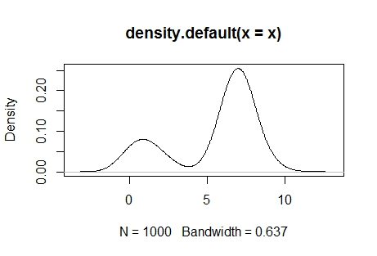
The EM algorithm for a mixture normal distribution
set.seed(45321)
tau_1_true <- 0.25
x <- y <- rep(0,1000)
for( i in 1:1000 ) {
if( runif(1) < tau_1_true ) {
x[i] <- rnorm(1, mean=1)
y[i] <- "heads"
} else {
x[i] <- rnorm(1, mean=7)
y[i] <- "tails"
}
}
plot(density(x))

Slide 3
print( x[1] )
##[1] 8.965741
dnorm( x[1], mean=0 )
##1.398409e-18
dnorm( x[1], mean=1 )
##[1]6.641388e-15
## It is more likely that x[1] came from the second distribution

Slide 4
tau_1 <- 0.5 ## our initial believed proportion from dist. 1, chosen arbitrarily
tau_2 <- 0.5 ## our initial believed proportion from dist. 2, chosen arbitrarily
T_1 <- tau_1 * dnorm( x[1], mean=0 )
T_2 <- tau_2 * dnorm( x[1], mean=1 )
print(T_1 )
print(T_2)
T_1 / (T_1 + T_2)
##[1] 3.169958e-14
T_1 <- tau_1 * dnorm( x, mean=0 )
T_2 <- tau_2 * dnorm( x, mean=1 )
head( T_1 / (T_1 + T_2) )
##[1] 0.0002105154 0.0008004465 0.3490351162 0.6116907302 0.0001333083 0.0005596835

Slide 5
## 2nd step of EM algorithm-weighted averages
P_1 <- T_1 / (T_1 + T_2)
P_2 <- T_2 / (T_1 + T_2)
mu_1 <- sum( P_1 * x ) / sum(P_1)
mu_2 <- sum( P_2 * x ) / sum(P_2)
##[1] 0.6326011 6.2239411

Slide 6
##Incorporate everything into 1 code and run n iterations
## set the initial guesses for the distribution parameters
mu_1 <- 0
mu_2 <- 1
## as well as the latent variable parameters
tau_1 <- 0.5
tau_2 <- 0.5
for( i in 1:10 ) {
## Given the observed data, as well as the distribution parameters,
## what are the latent variables?
T_1 <- tau_1 * dnorm( x, mu_1 )
T_2 <- tau_2 * dnorm( x, mu_2 )
P_1 <- T_1 / (T_1 + T_2)
P_2 <- T_2 / (T_1 + T_2) ## note: P_2 = 1 - P_1
tau_1 <- mean(P_1)
tau_2 <- mean(P_2)
## Given the observed data, as well as the latent variables,
## what are the population parameters
mu_1 <- sum( P_1 * x ) / sum(P_1)
mu_2 <- sum( P_2 * x ) / sum(P_2)

Slide 7
## print the current estimates
print( c(mu_1, mu_2, mean(P_1)) )}
##fast convergence
[1] 0.5445323 6.0696139 0.1043686
[1] 0.8818943 6.9596054 0.2413139
[1] 0.9730759 7.0149377 0.2519039
[1] 0.9785369 7.0170236 0.2523902
[1] 0.9788304 7.0171300 0.2524156
[1] 0.9788459 7.0171356 0.2524169
[1] 0.9788468 7.0171359 0.2524170
[1] 0.9788468 7.0171359 0.2524170
[1] 0.9788468 7.0171359 0.2524170
[1] 0.9788468 7.0171359 0.2524170
>

Slide 8
Readings
http://rstudio-pubs-static.s3.amazonaws.com/1001_3177e85f5e4840be840c84452780db52.html
Dempster, A. P., Laird, N. M., & Rubin, D. B. (1977). Maximum likelihood from incomplete data via the EM algorithm. Journal of the royal statistical society. Series B (methodological), 1-38.

